Slide 1

COURIER MANAGEMENT SYSTEM

Slide 2
ABC INSTITUTE OF TECHNOLOGY & RESEARCH
Guided By: Presented By:
Prof. Mmmmmmm XYZ

Slide 3
DEVELOPER
XYZ

Slide 4
ABSTRACT
This project deals with the ‘Courier Management System ’. The system is used for daily activities such as booking, Booking history ,staff details, Branch details and pickup centers. It is very difficult to do this process manually. Hence it is recommended to computerize the process by developing the relative software as the world is turning into information and technology; computerization becomes necessity in all walks of life.

Slide 5
EXISTING SYSTEM
The existing system is not totally automated. Though the system is computerized to a particular extent, it has to do a lot of manual work.
The different processes involved are:
To maintain details of bookings manually.
Maintain details of the employees.
To maintain details of the incoming couriers.
To maintain full courier details.

Slide 6
ADMIN MODULES
1. Dashboard: In this section admin can see all detail in brief like total courier, Total Courier Pickup, Total Shipped, Total In-transit, Total Courier arrived at destination, Total courier out for delivery and Total delivered courier.
2. Branches: In this section admin can manage branches(add and update).
3. Staffs: In this section admin can manage Staffs(add, update and delete).

Slide 7
ADMIN MODULES
4. Courier: In this section admin can view courier status and check the courier detail which is filling by staff of different branches.
5. Reports: In this section admin can view courier details, courier counts and sales report according to dates.
Admin can also update his profile and change password.

Slide 8
STAFF MODULES
Dashboard: In this section staffs can see all detail in brief like total courier , Total Courier Pickup, Total Shipped, Total In-transit, Total Courier arrived at destination, Total courier out for delivery and Total delivered courier.
Add Courier: In this section staffs fill the courier detail of parcel.
Status: In this section staffs can view the courier details and they have also right to change courier status according to current status.

Slide 9
STAFF MODULES (continue)
Search Courier: In this section staffs can search particular courier with the help of tracking number/reference number.
Staffs can also update his profile and change password.

Slide 10
USER MODULES
In this module user can view current delivery status of his parcel and also view the different branches of Courier Company.

Slide 11
PURPOSE
This project deals with the ‘Courier Management System’. The system is used for daily activities such as booking, history of courier,staff details and branches. It is very difficult to do this process manually. Hence it is recommended to computerize the process by developing the relative software as the world is turning into information and technology; computerization becomes necessity in all walks of life.

Slide 12
PURPOSE
Why the new system?
Nowadays, people are very busy and they don’t find much time to go to a dealer to get products. But they need to buy products. And most of the people are accessing Internet.
Then why don’t we help them in searching & getting products online. Of course this is helpful for company & dealer also to improve the sales.

Slide 13
SCOPE
Courier management system computerization is “the incorporate of appropriate technology to help administrator manage information. Technology is considered appropriate, when it utilizes the most abundant domestic resources and conserves capital and skilled personnel”.
This project deals with the maintenance of booking details, incoming courier details, courier non delivery details and courier return details etc. the main aim of this project is to computerize the maintenance of courier management.

Slide 14
PROPOSED SYSTEM:
The Proposed system ensures the complete freedom for users, where user at his own system can logon to this website and can book his product. Our proposed system allows only registered users to book the product, view booking and cancel their booking as per their need.
In this Proposal the entire work is done on online. Here customer can send their queries and suggestions through a feedback form.

Slide 15
SYSTEM DESIGN
Unified Modeling Language:
UML stands for Unified Modeling Language. It is a third generation method for specifying, visualizing and documenting the artifacts of an object oriented system under development. Object modeling is the process by which the logical objects in the real world (problem space) are represented (mapped) by the actual objects in the program (logical or a mini world). This visual representation of the objects, their relationships and their structures is for the ease of understanding. This is a step while developing any product after analysis.

Slide 16
The Unified Modeling Language encompasses a number of models.
Use case diagrams
Class diagrams
Sequence diagrams

Slide 17
Use Case Diagram:
Use case diagram consists of use cases and actors and shows the interaction between them. The key points are:
The main purpose is to show the interaction between the use cases and the actor.
To represent the system requirement from user’s perspective.
The use cases are the functions that are to be performed in the module.
An actor could be the end-user of the system or an external system.

Slide 18
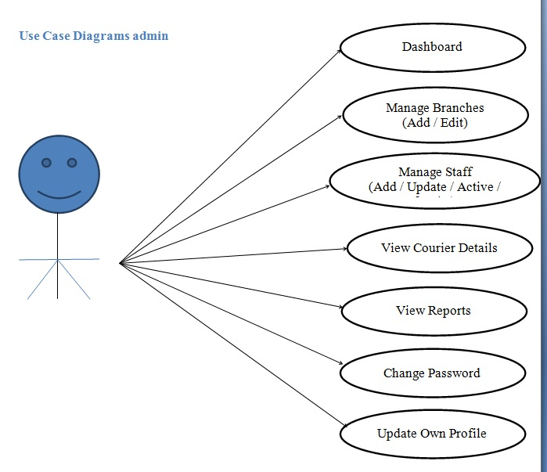
Use Case Diagram between ADMIN and SYSTEM:

Slide 19
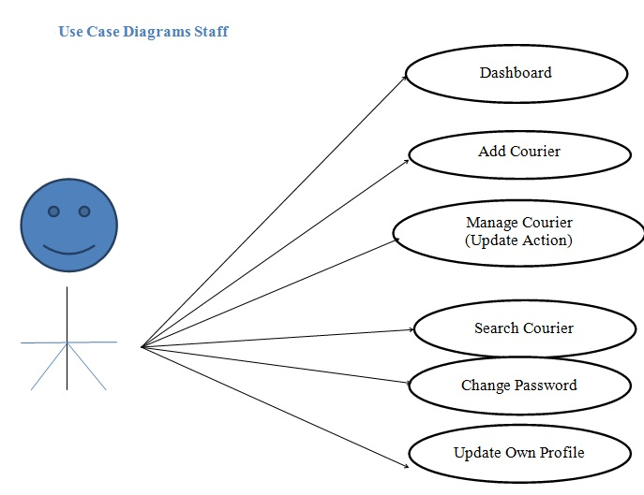
Use Case Diagram between USER and SYSTEM:

Slide 20
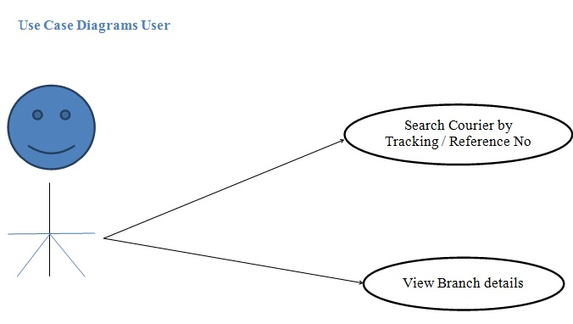
Use Case Diagram between USER and SYSTEM:

Slide 21
Sequence Diagram:
The purpose of sequence diagram is to show the flow of functionality through a use case. In other words, we call it a mapping process in terms of data transfers from the actor through the corresponding objects.

Slide 22
SEQUENCE DIAGRAM

Slide 23
Sequence Diagram For Administrator:-
Login
Application
Database
Login
:Request
:Validate()
:executeQuery()
Response
Show Result
Failed:show()

Slide 24
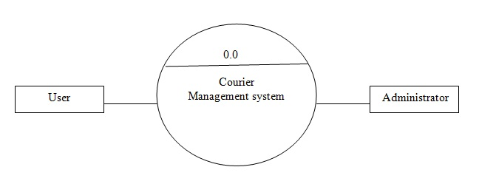
DFD(Data Flow Diagram) Zero Level

Slide 25
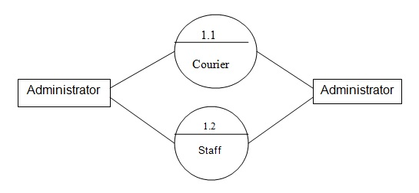
DFD(First Level)

Slide 26
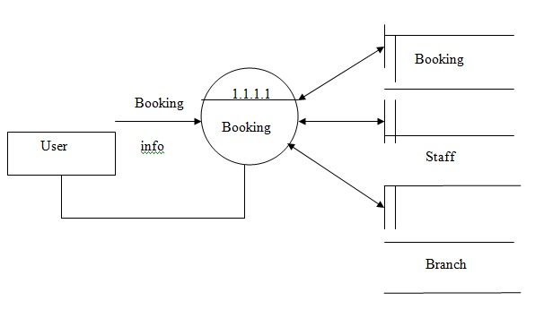
DFD(Second Level)

Slide 27
ER DIAGRAM

Slide 28
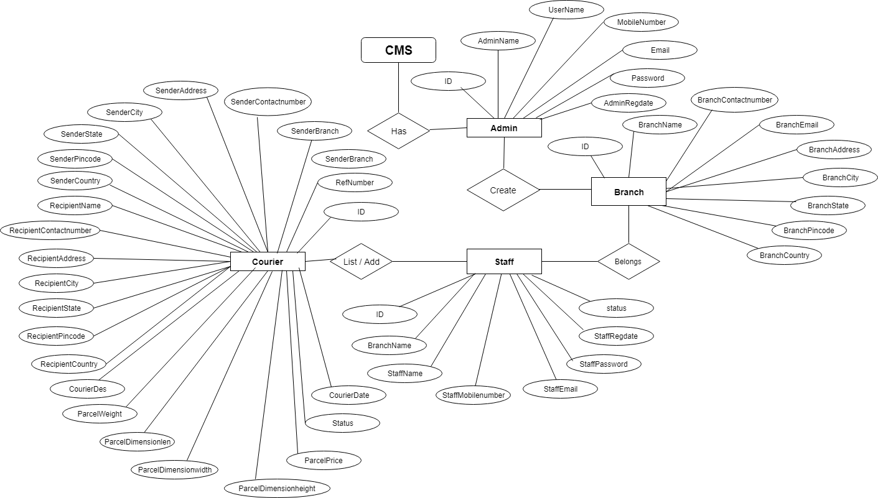

Slide 29
FRONTEND (LANGUAGE USED)
HTML(Hypertext Markup Language)
CSS(Cascading Stylesheet)
JAVASCRIPT
BOOTSTRAP(Framework of CSS and Javascript)

Slide 30
BACKEND
PHP (SERVER SIDE LANGUAGE)
MYSQL (DATABASE)

Slide 31
Software Used
XAMPP(Cross Platform Apache Mysql PHP Perl)
Notepad++/Sublime or any other text editor.
Chrome or any other browser.

Slide 32
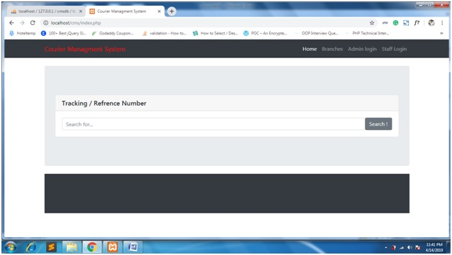
SCREEN SHOTS Home Page

Slide 33
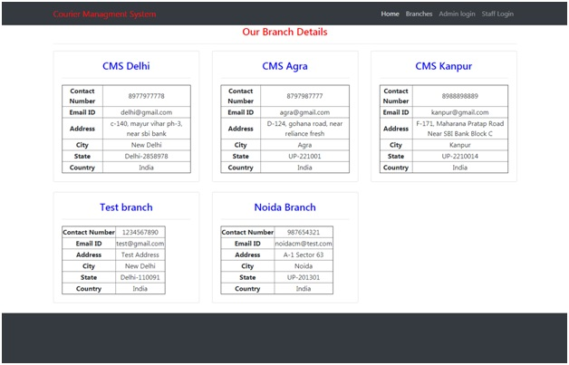
Branch Detail Page

Slide 34
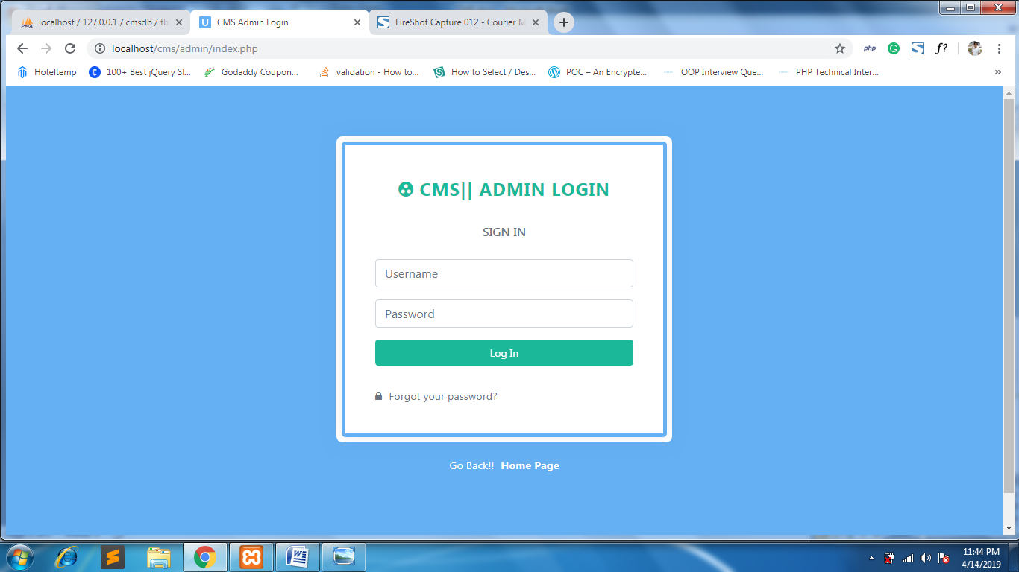
ADMIN LOGIN PAGE

Slide 35
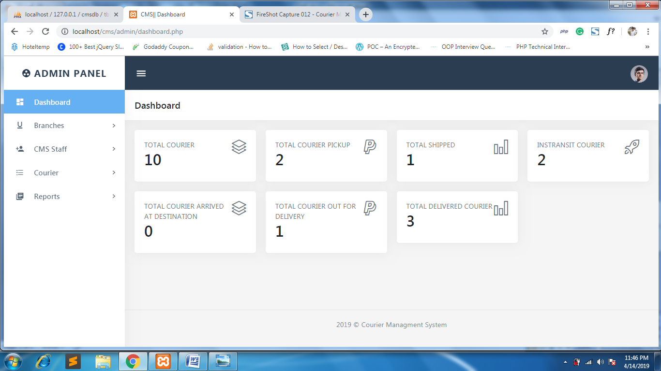
ADMIN DASHBOARD PAGE

Slide 36
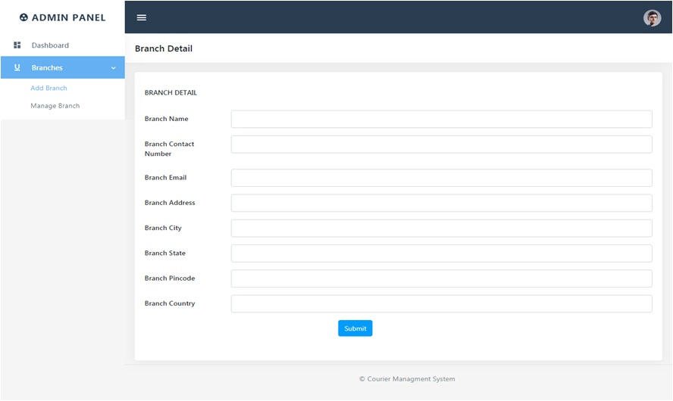
ADD BRANCH PAGE

Slide 37
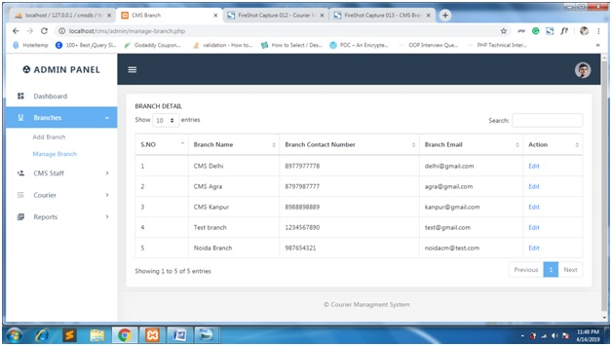
MANAGE BRANCH PAGE

Slide 38
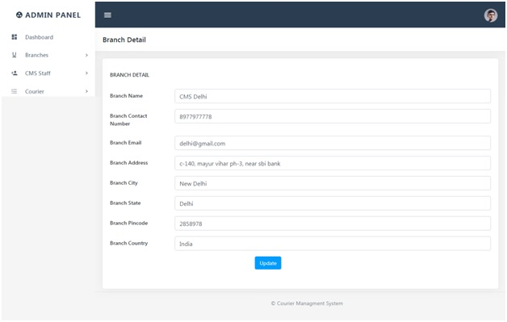
EDIT BRANCH PAGE

Slide 39
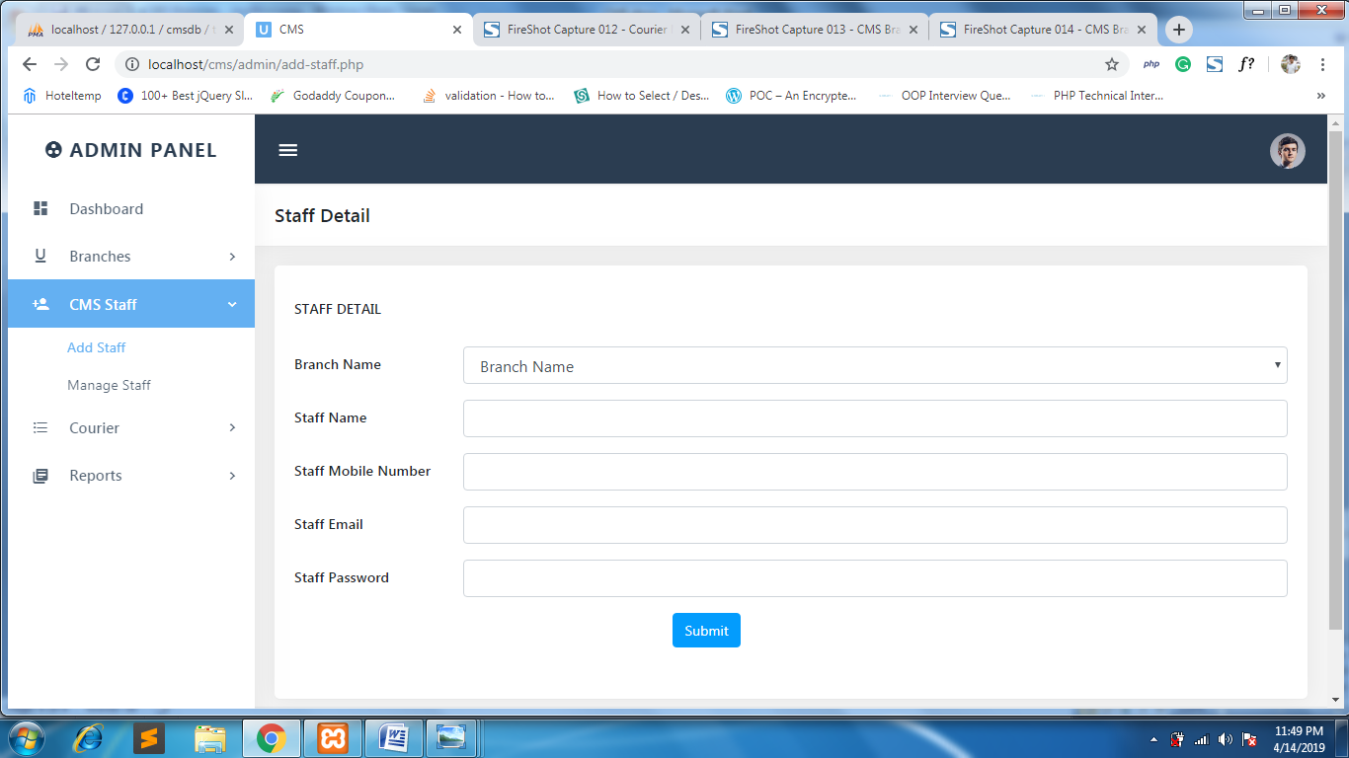
ADD STAFF PAGE

Slide 40
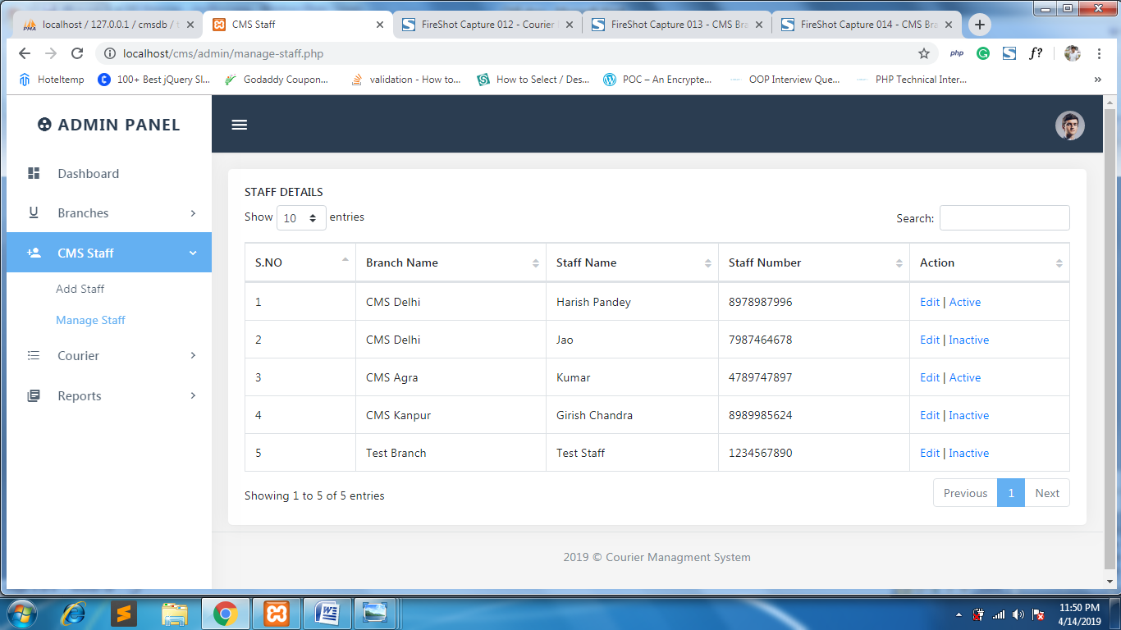
MANAGE STAFF PAGE

Slide 41
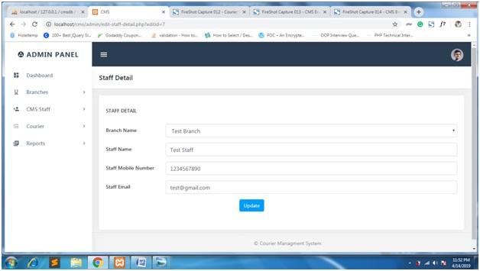
EDIT STAFF DETAIL PAGE

Slide 42
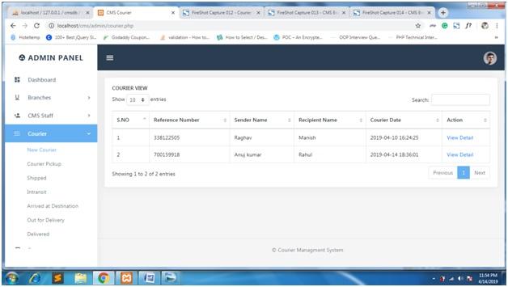
MANAGE COURIER DETAIL PAGE

Slide 43
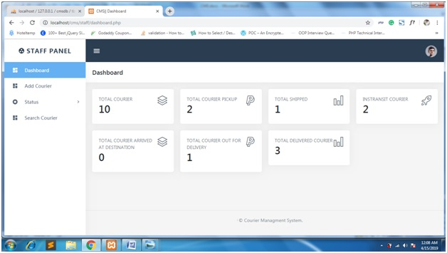
STAFF DASHBOARD PAGE

Slide 44
CONCLUSION & FUTURE SCOPE
FUTURE SCOPE
This web application involves almost all the basic features of the online courier management. The future implementation will be online help for the users and chatting with website administrator.
CONCLUSION
The project entitled “Online Courier Management System” is developed using HTML , CSS and Bootstrap as front end and PHP , MYSQL database in back end to computerize the process of courier management. This project covers only the basic features required.

Slide 45
BIBLIOGRAPHY
FOR PHP INSTALLATION
www.php.net
FOR DEPLOYMENT AND PACKING ON SERVER
www.developer.com
www.15seconds.com
FOR MYSQL
www.mysql.com
FOR PHP,CSS,APACHE
www.w3schools.com
www.php.net
www.javatpoint.com
www.apache.org

Slide 46
THANKYOU

